Slide 1

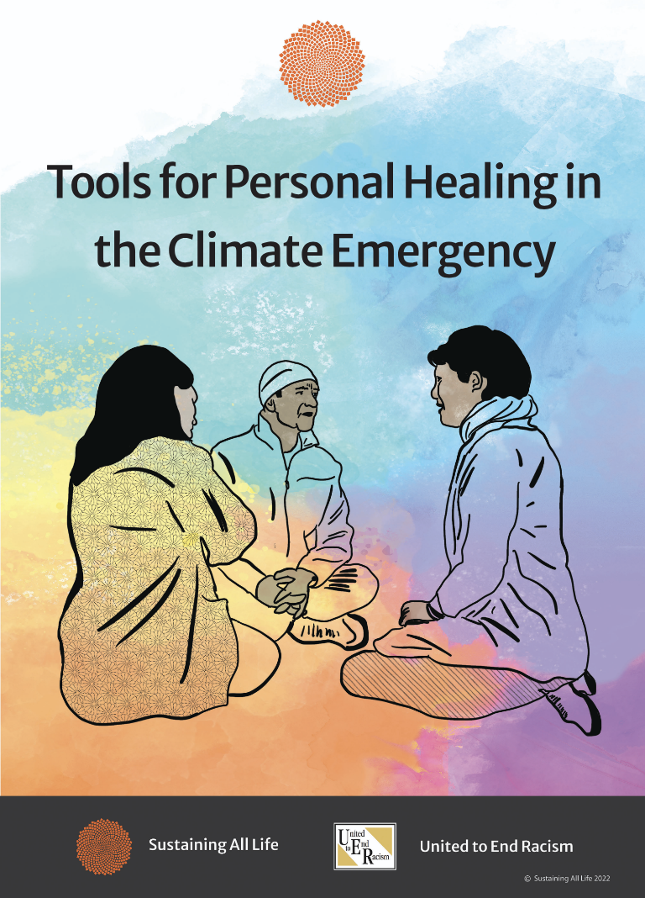

Slide 5
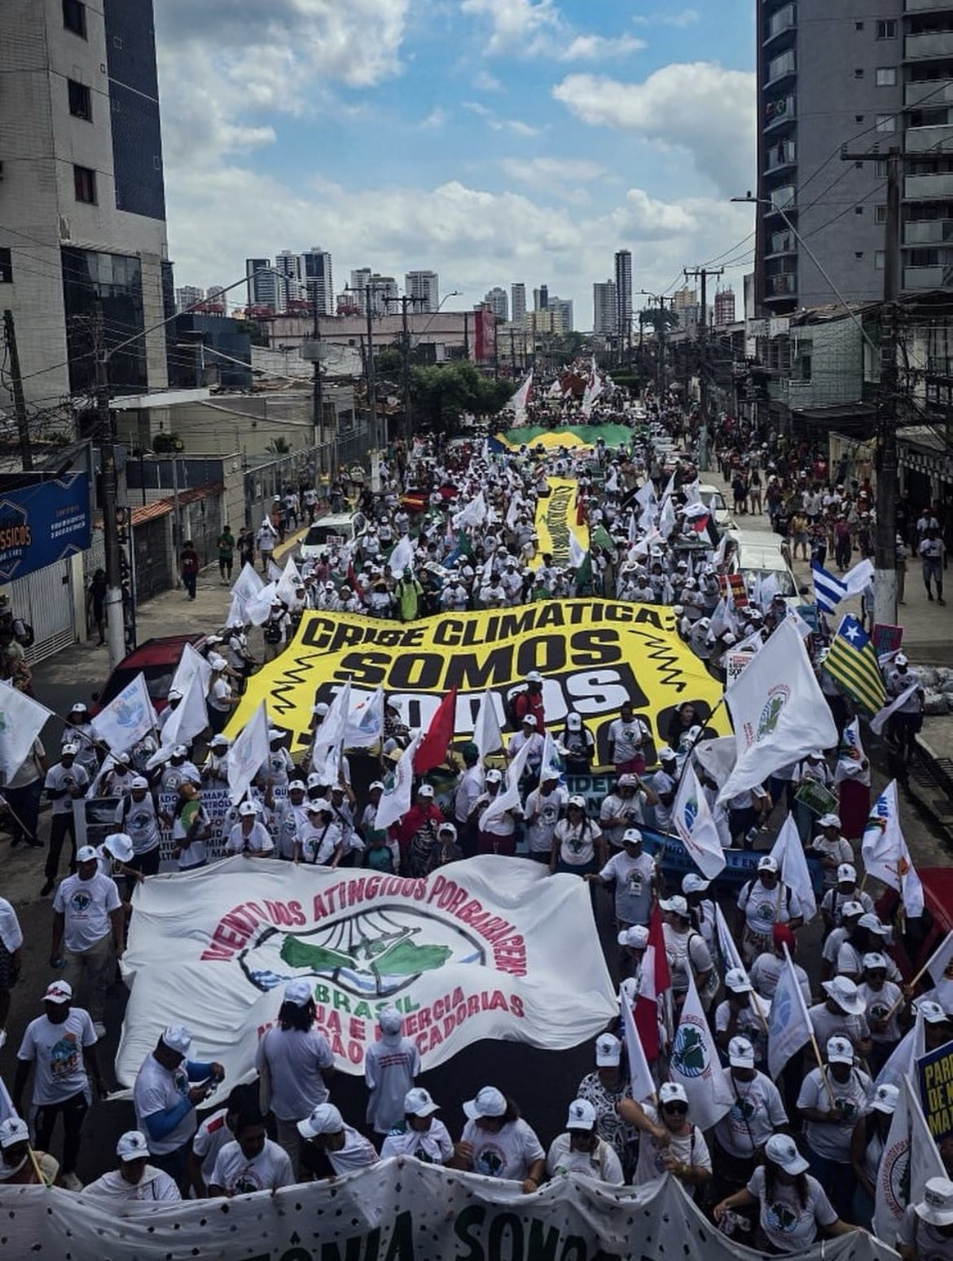

Slide 6
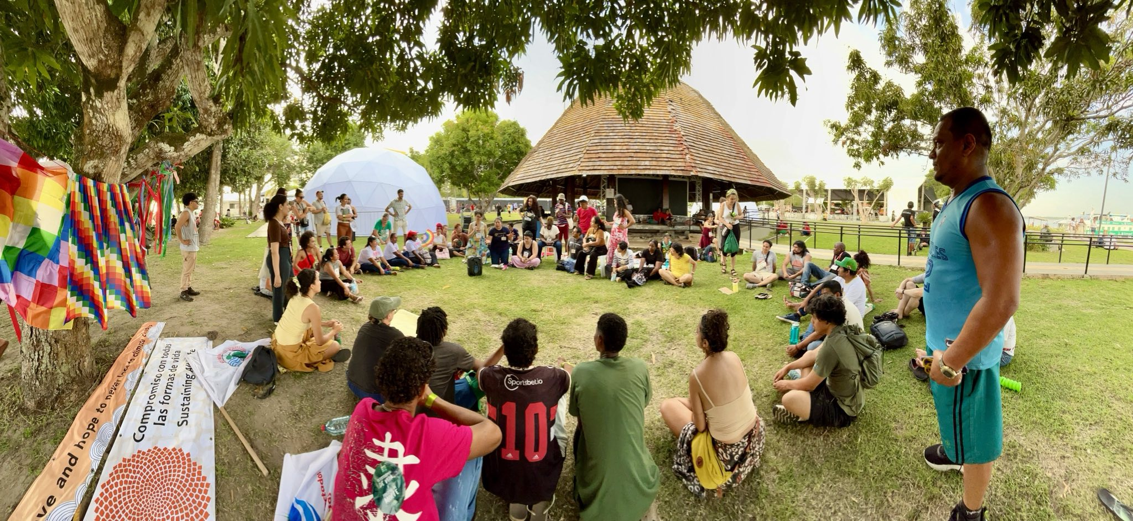

Slide 7


Slide 8
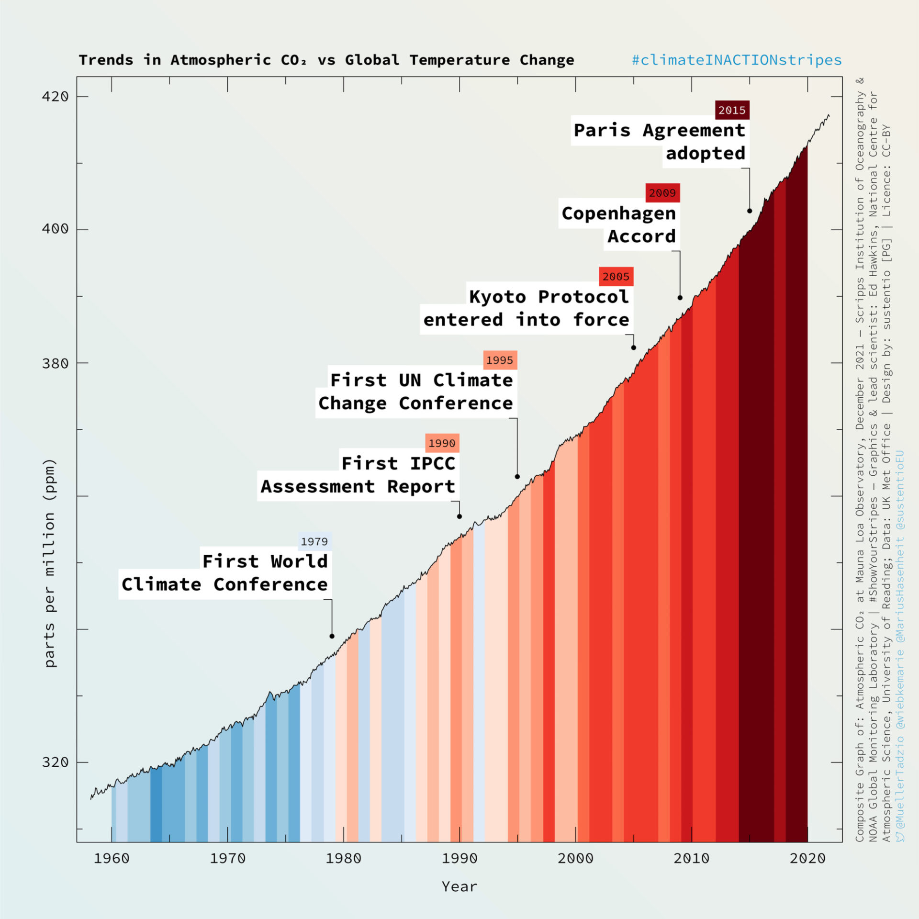
Notes:
Showing the ongoing rise in C02 and temperature, correlated with the various global Climate Change Conferences.

Slide 9
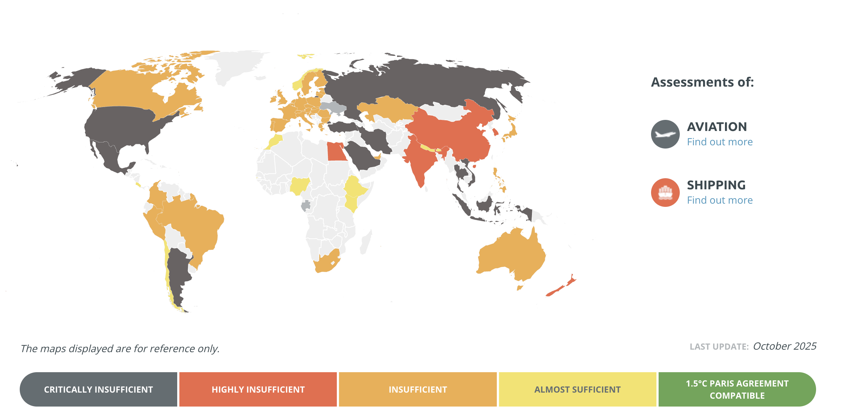

Progress toward meeting Paris Commitments
Notes:
Carbon Action Tracker, updated October 2025. Shows countries progress toward meeting their commitments under the Paris Agreement. Updated December 2023. Grey areas are where there is no data.

Slide 10
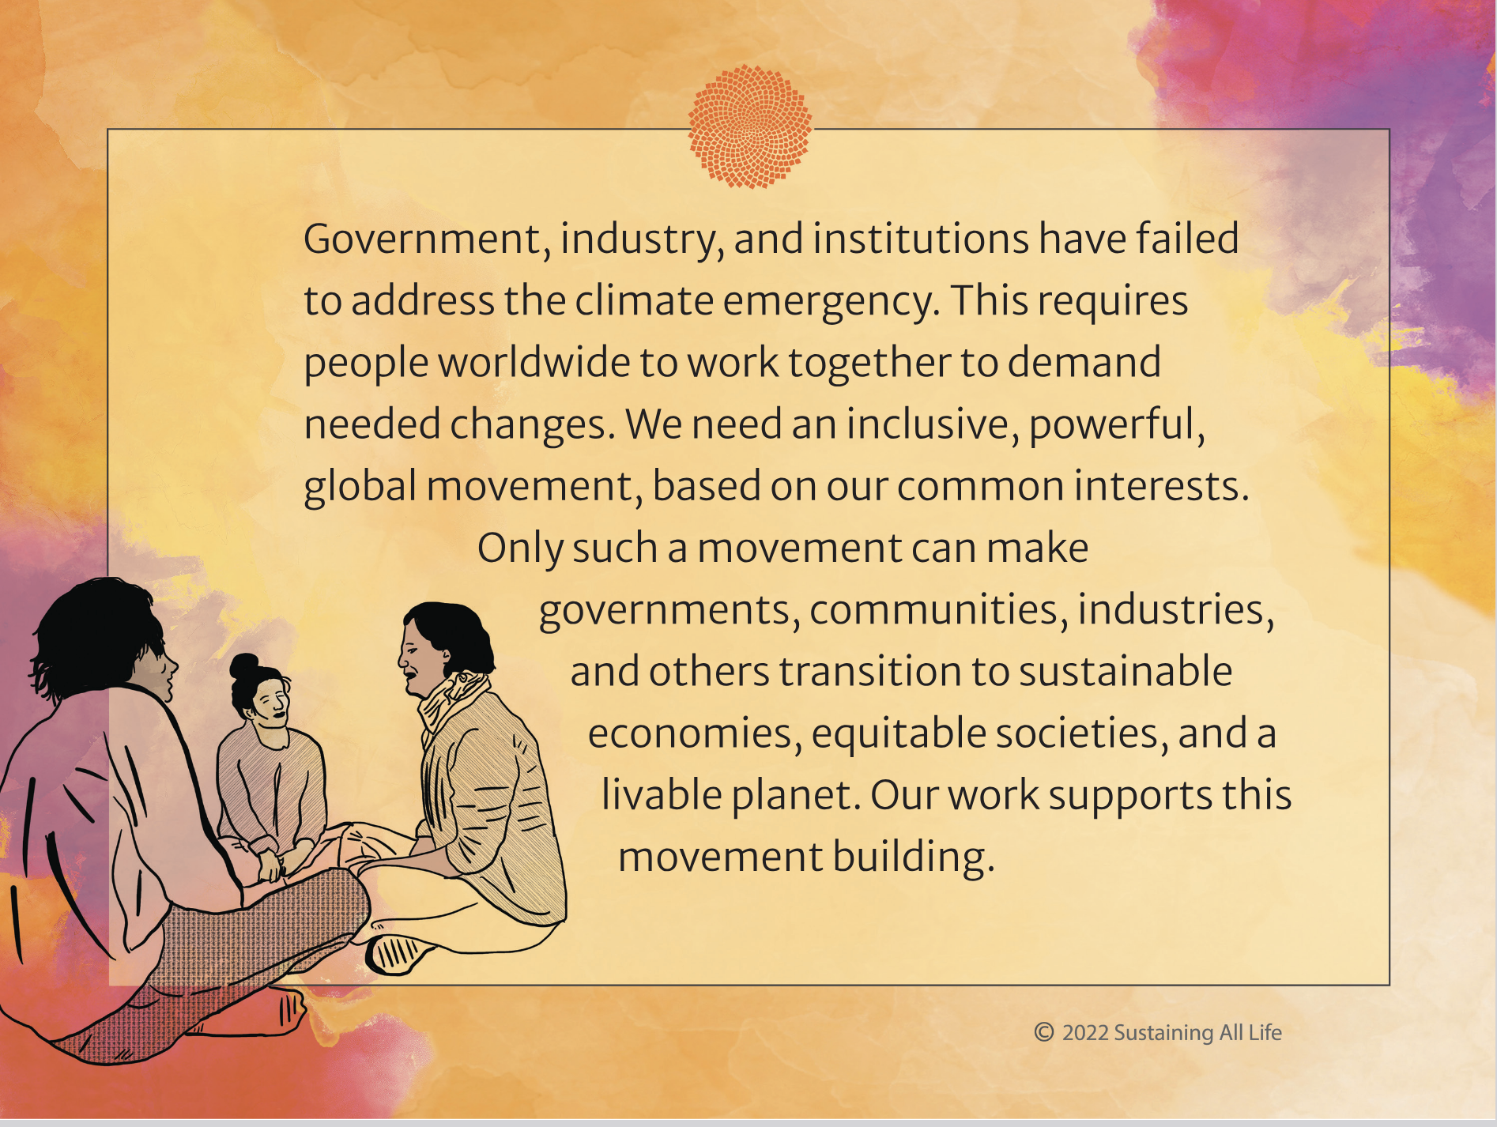

Slide 11
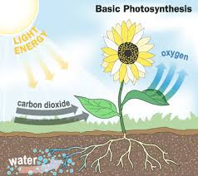
Notes:
The basic process of photosynthesis where plants absorb carbon dioxide (CO2) from the atmosphere and water from the land, and with energy from the sun (the original solar energy) process it into oxygen, which is released into the atmosphere, and carbon, which is later stored in living biomass (as grass or trees, for example) or as organic matter in the soil. Depending on form of biomass or soil organic matter, this carbon can be stored on land, away from the atmosphere, for a season, several years, multiple decades, or several centuries. Ultimately, the carbon that is locked up in biomass or soil organic matter is returned to the atmosphere, through decomposition and microbial respiration. Project Drawdown,

Slide 12
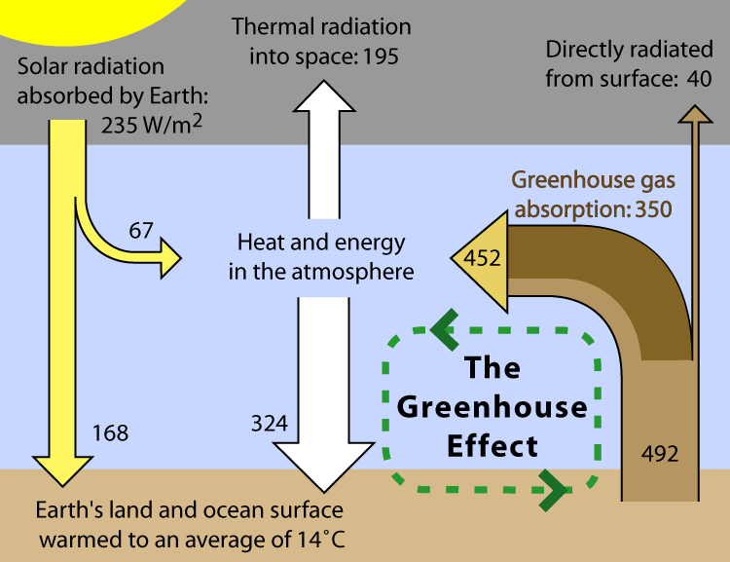
0
CO₂ and energy in the atmosphere
The Earth’s surface absorbs solar radiation, and reradiates it as heat.
CO₂ and other greenhouse gases (GHG) reduce the rate at which this heat can escape into space.
The more GHG, the more heat is trapped and the higher the global temperature.
This role of CO₂ and other GHG has been understood for over a century.
Notes:
Carbon cycle: carbon has been cycling back and forth between oceans, biomass, soil, and the atmosphere, for billions of years. Carbon is only a pollutant in the atmosphere because there is too much of it.
Not that much atmosphere—tiny layer. If Earth is an onion, atmosphere is the thickness of the skin.
Source: http://commons.wikimedia.org/wiki/File:Greenhouse_Effect.png
“This figure is a simplified, schematic representation of the flows of energy between space, the atmosphere, and the Earth's surface, and shows how these flows combine to trap heat near the surface and create the greenhouse effect. Energy exchanges are expressed in watts (energy conversion with respect to time) per square meter (W/m2),” exchanges derived from Kiehl, J. T. and Trenberth, K. E. (1997). "Earth's Annual Global Mean Energy Budget". Bulletin of the American Meteorological Association 78: 197-208.

Slide 13
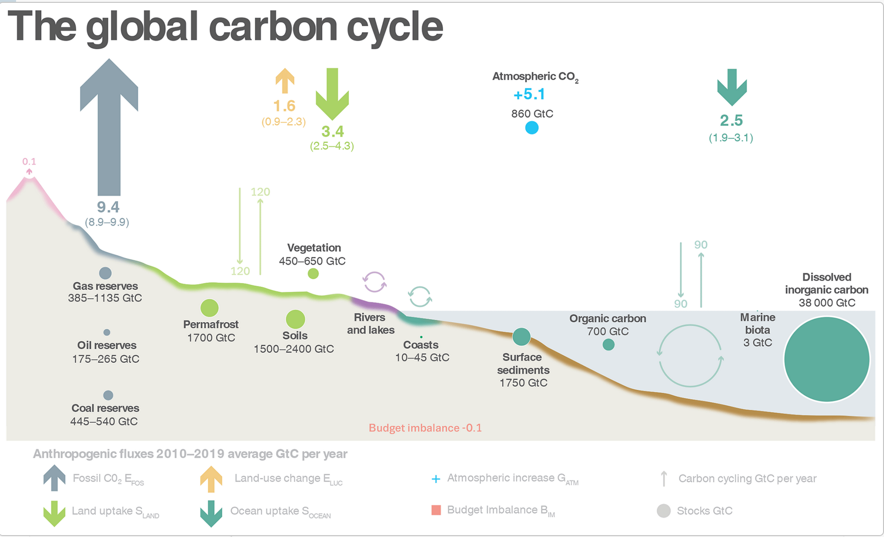
Notes:
The global carbon cycle caused by human activities, averaged globally for the decade 2010 to 2019. Today, nearly 41% of our greenhouse gases are quickly absorbed by Earth’s oceans and land-based ecosystems, leaving about 59% of our greenhouse gas emissions in the atmosphere, which are contributing to climate change. Global Carbon Budget 2020, https://essd.copernicus.org/articles/12/3269/2020/; Project Drawdown

Slide 14
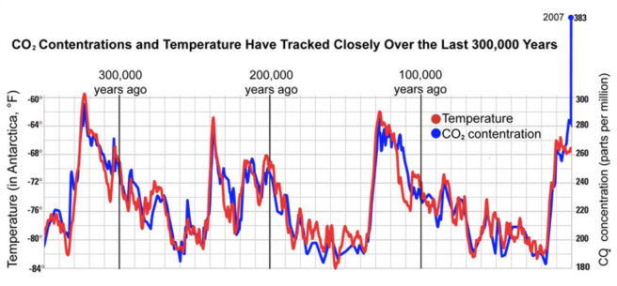
Notes:
The amount of CO2 over the last million years or so has held relatively steady averaging about 280 parts per million (PPM—percentage of CO2 in the atmosphere). The safe range is between 300 and 350 PPM; we are currently (May 2020) at 416 PPM. This graph shows that temperature rise closely follows CO2 rise; and falls when CO2 levels fall. On the far right you can see that in the current period (since the industrial revolution in the late 1700s, when we started burning coal for fuel), CO2 levels have risen steadily. Temperature rise takes about 40 years to catch up to CO2 level rise. So the temperature rise we are experiencing now results from the CO2 levels 40 years ago. In 2060 we will feel the temperature rise from the current CO2 levels (416 PPM).

Slide 15
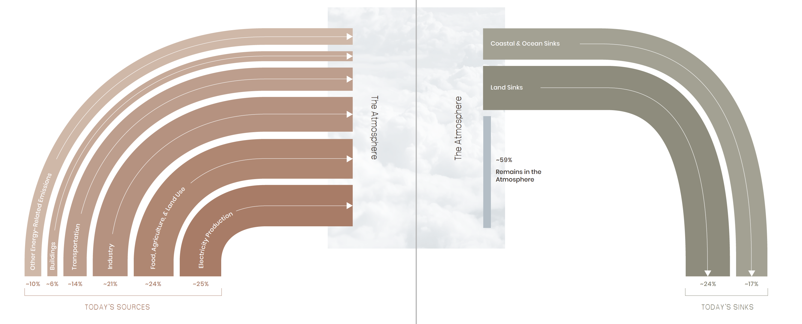
Sources of GHGs
Drawdown (2020) The Drawdown Review 2020
Notes:
On the left you see the sources of greenhouse gasses entering the atmosphere (primarily from burning fossil fuels to produce electricity, and for manufacturing, transportation, buildings). 24% is from agriculture and other land and food sources. The vast majority of these emissions come from the actions of wealthy people in wealthy countries.
The right side of the graph depicts the two major GHG “sinks.” Sinks are parts of the natural ecosystem that absorb GHG from the atmosphere. Land (including trees, plants, soil) and the ocean (including the water, plants and marine animals).
The natural sinks are only able to absorb 41% of the GHGs; the rest remain in the atmosphere, heating the planet. The CO2 absorbed by the ocean increases its acidity, causing other difficulties.

Slide 16
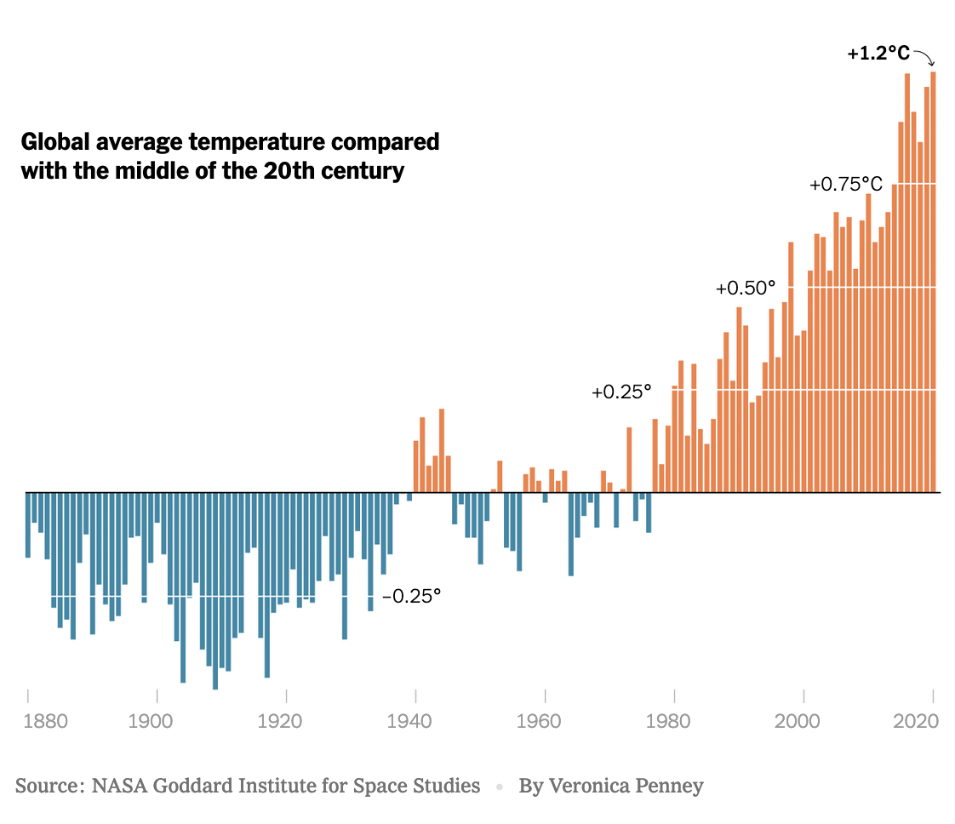
Notes:
A picture is worth a thousand words.

Slide 17
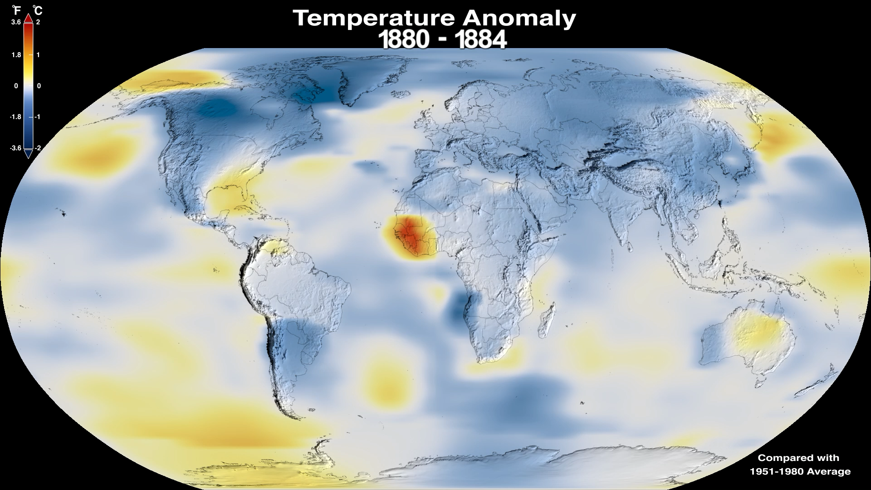
Notes:
The time series above shows the five-year average variation of global surface temperatures. Dark blue indicates areas cooler than average. Dark red indicates areas warmer than average. NASA, www.climate.nasa.gov

Slide 18
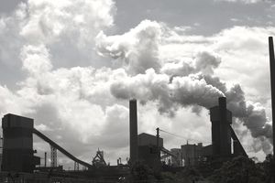
What Will It Take to Limit the Increase To 1.5F?
45% emissions reduction by 2030
Net Zero by 2050 (new data says sooner)
Notes:
To stay within the 1.5 degree target we need to cut carbon pollution by 45% by 2030
We will need reach net zero by 2050 (no more carbon emissions than we remove)

Slide 19
Reaching Net Zero
No home, business, or industry heated by gas or oil; replace with renewable energy
No vehicles powered by diesel or gasoline; all coal and gas power plants shuttered;
Conversion of the petrochemical industry to green chemistry;
No carbon energy sources for heavy industry unless CO2 is captured and permanently stored;
Industrial agriculture replaced by regenerative agriculture;
Large-scale restoration of ecosystems…
Notes:
This means
no home, business, or industry heated by gas or oil;
no vehicles powered by diesel or gasoline; all coal and gas power plants shuttered;
the petrochemical industry converted wholesale to green chemistry; and
heavy industry like steel and aluminum production either using carbon-free energy sources or employing technology to capture CO2 emissions and permanently store it.
Industrial agriculture replaced by regenerative agriculture
Large scale restoration of ecosystems to capture and store CO2 naturally

Slide 20
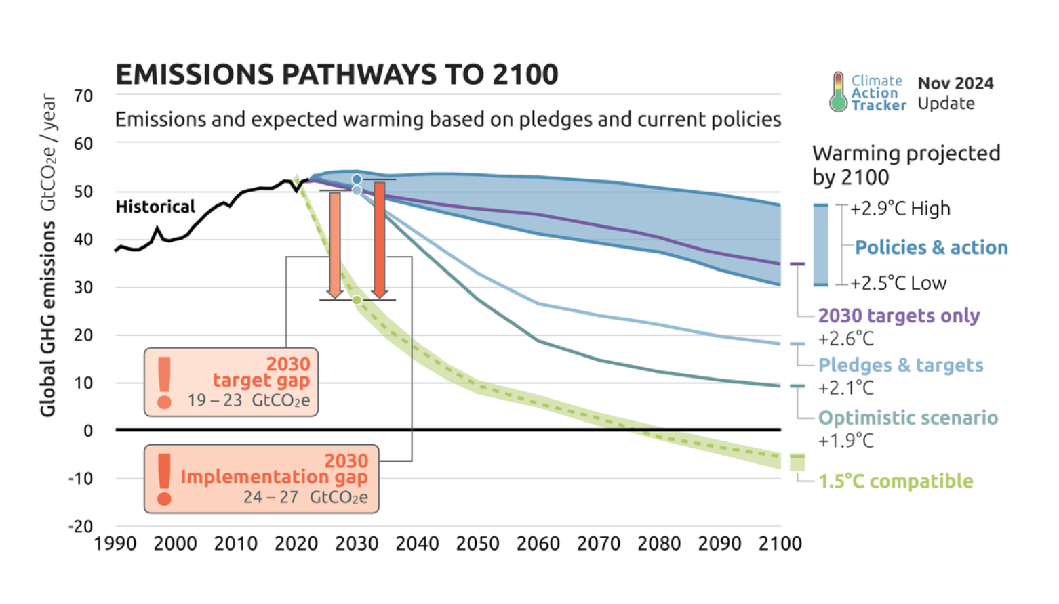

Slide 21
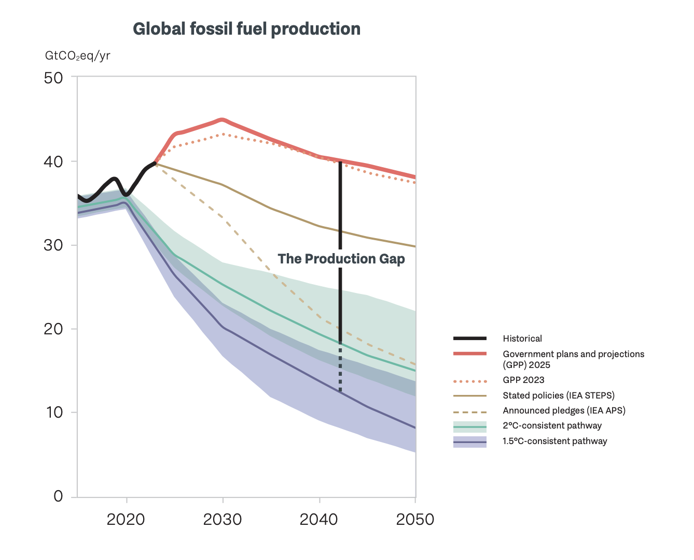
Notes:
Illustrates the gap between emissions reductions needed to stay below 1.5 degrees and emissions expected from government plans and projects for fossil fuel development. The Production Gap 2025

Slide 22
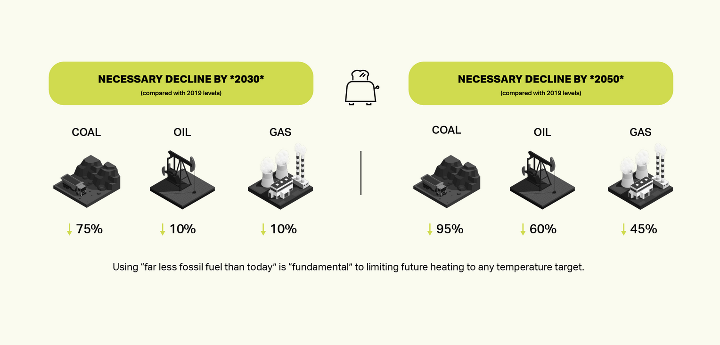
NECESSARY DECLINE IN FOSSIL FUEL USE
Notes:
Specifics about how much less fossil fuels we need to use between now and 2030 and 2050.

Slide 23
Tipping Points
Lenton (2019) “Climate tipping points – Too risky to bet against”
Notes:
Tipping points are climate reactions triggered by temperature rise that escalate with a domino effect, causing even worse impacts. Reaching these tipping points could cause meters of sea level rise from ice sheet melt with resulting flooding of coastal cities and slowing of ocean currents; loss of tropical corals with a profound loss of marine biodiversity; an abrupt carbon and methane release back to the atmosphere, amplifying climate change and reducing remaining emission budgets; deforestation and climate change destabilizing the Amazon and 10% of the world’s species; fires and largescale insect disturbances causing dieback of forests, potentially changing some regions so that instead of absorbing carbon they release it. Only by keeping temperature rise below 1.5°C can we avoid triggering these tipping points.
Reaching some of these tipping points would cause us to reach a ”point of no return.”
Climate tipping Points, too risky to bet against, Nature, Vol 575 | 28 November 2019

Slide 24
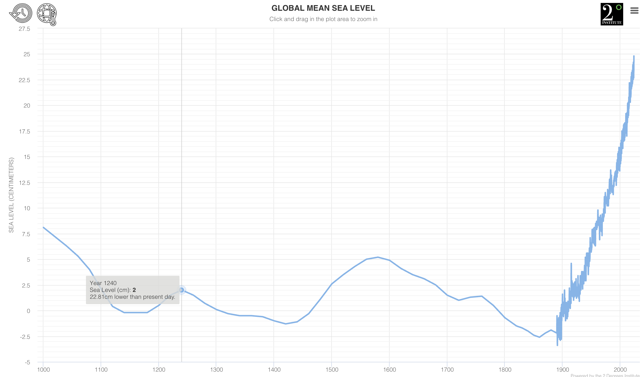

Slide 25
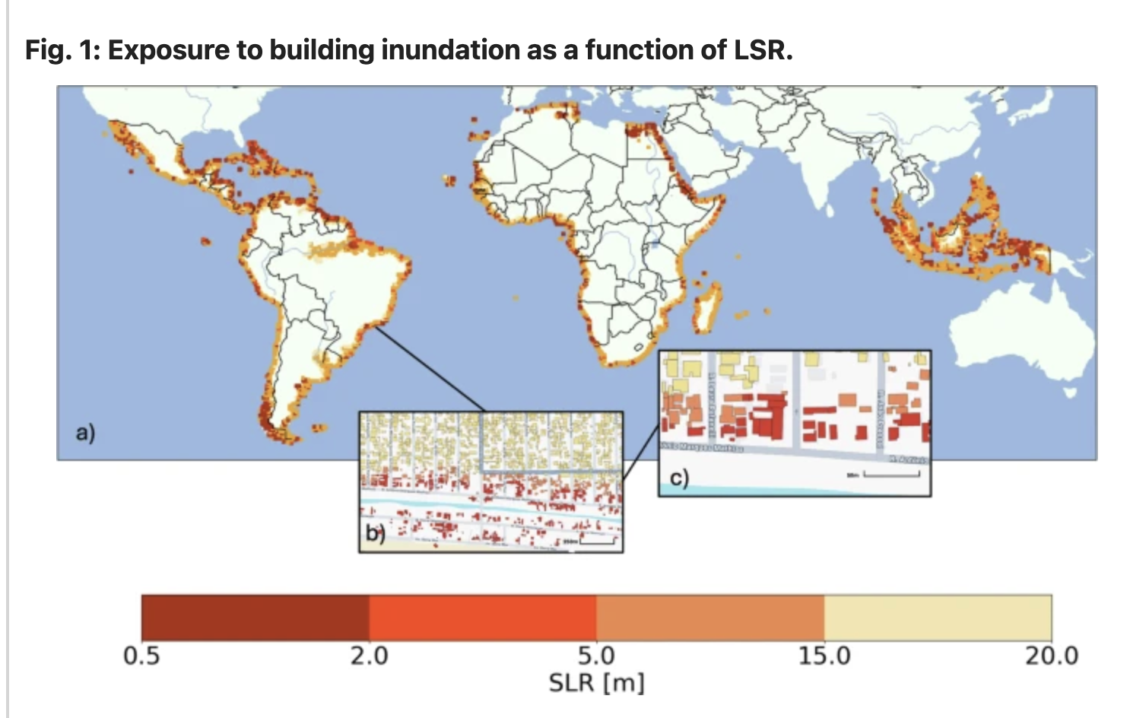
Notes:
Nature.com study GS countries—flooding of 5 million existing buildings at high tide by the end of this century. 0.7–0.9 m global mean SLR is likely to occur by 2100, and 2.2–2.5 m by 2300

Slide 26
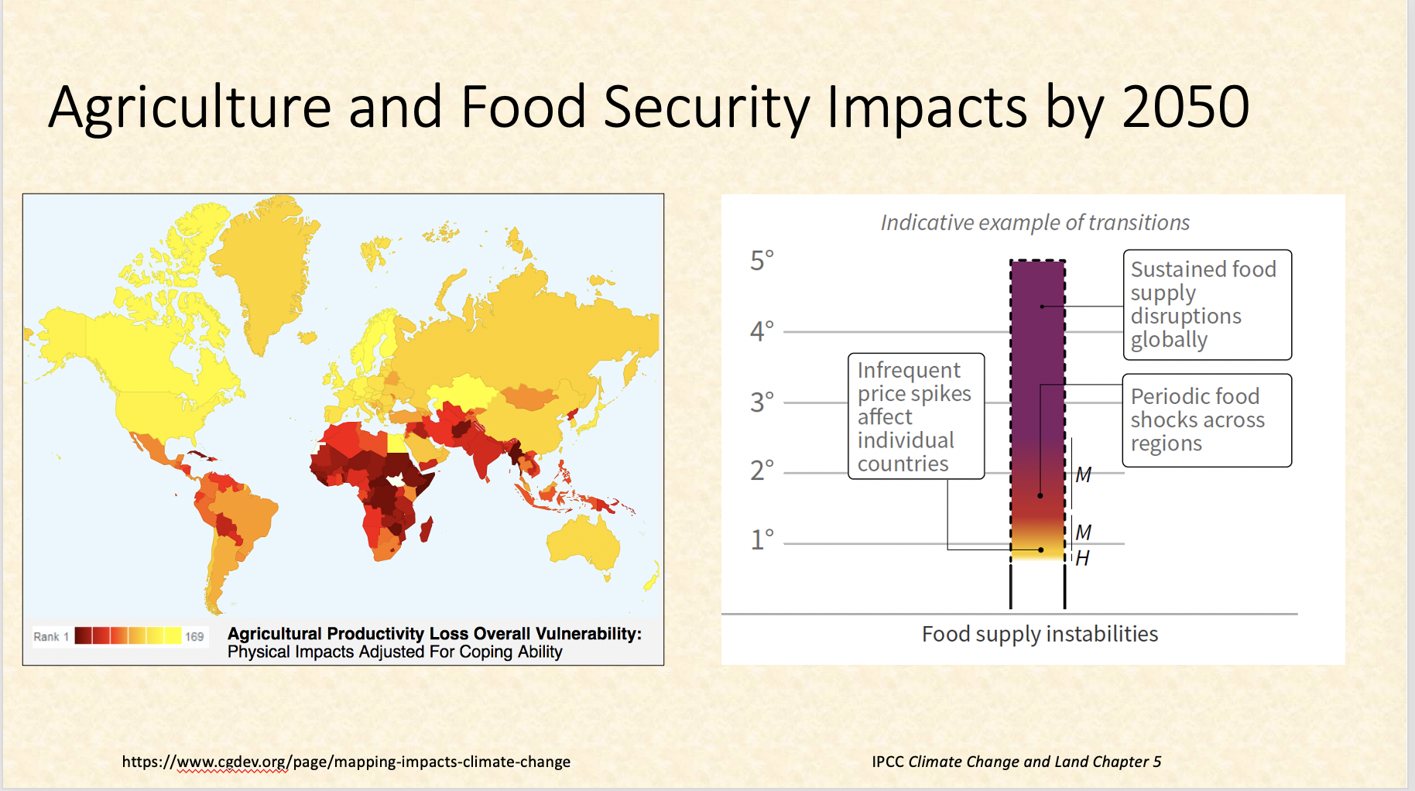
Notes:
Increases in global mean surface temperature, relative to pre-industrial levels, affect processes involved in desertification (water scarcity), land degradation (soil erosion, vegetation loss, wildfire, permafrost thaw) and food security (crop yield and food supply instabilities). Changes in these processes drive risks to food systems, livelihoods, infrastructure, the value of land, and human and ecosystem health. Changes in one process (e.g. wildfire or water scarcity) may result in compound risks. Risks are location-specific and differ by region. IPCC Climate Change and Land, A.5., p. 13.

Slide 27
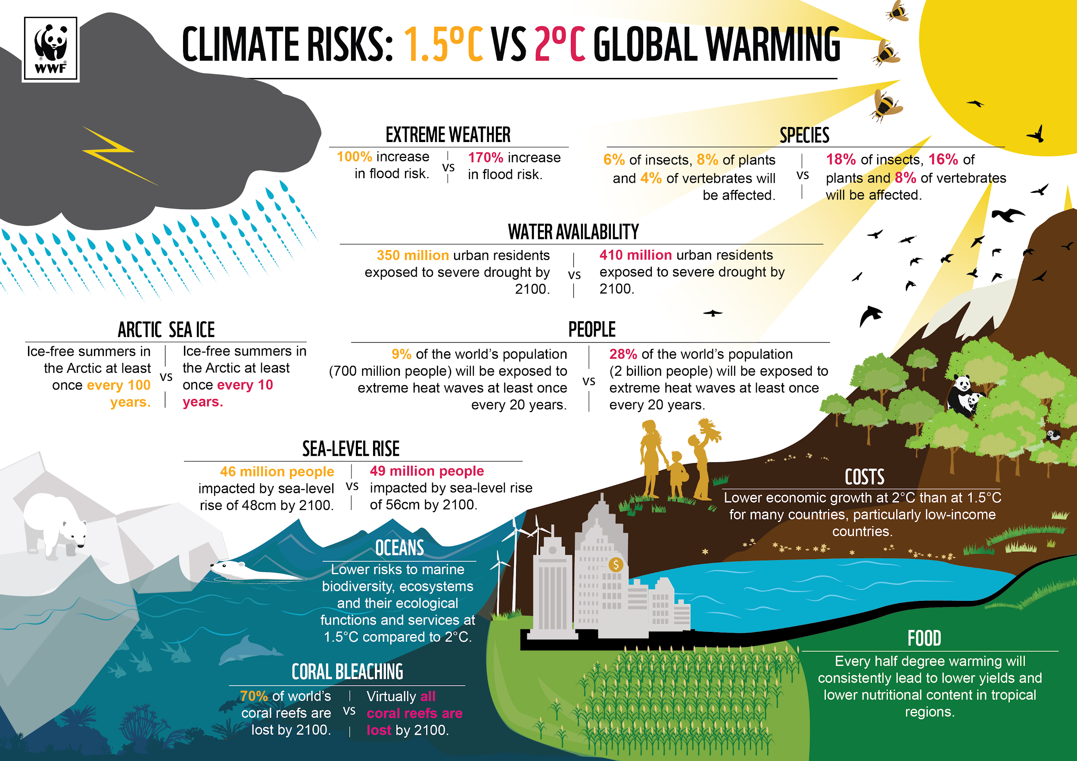

Half a Degree Makes a Big Difference!
Notes:
At 1.5C the proportion of the global population exposed to water stress could be 50% lower than at 2C, it notes. Food scarcity would be less of a problem and hundreds of millions fewer people, particularly in poor countries, would be at risk of climate-related poverty.
Insects, which are vital for pollination of crops, and plants are almost twice as likely to lose half their habitat at 2C compared with 1.5C. Corals would be 99% lost at the higher of the two temperatures, but more than 10% have a chance of surviving if the lower target is reached. – The Guardian
Sea-level rise would affect 10 million more people by 2100
Oceans are already suffering from elevated acidity and lower levels of oxygen as a result of climate change. One model shows marine fisheries would lose 3m tonnes at 2C, twice the decline at 1.5C.
Sea ice-free summers in the Arctic, which is warming two to three times faster than the world average, would come once every 100 years at 1.5C, but every 10 years with half a degree more of global warming.

Slide 28
